Slide 1

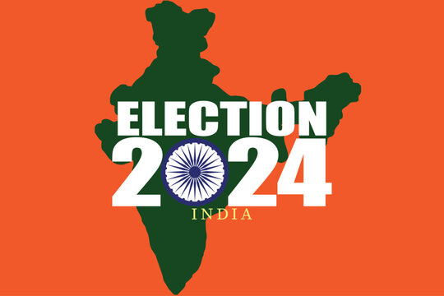
Analysis of 2024 Election Data using Power BI
Name – Priya Kumari
Batch – MIP-DA-11

Slide 2
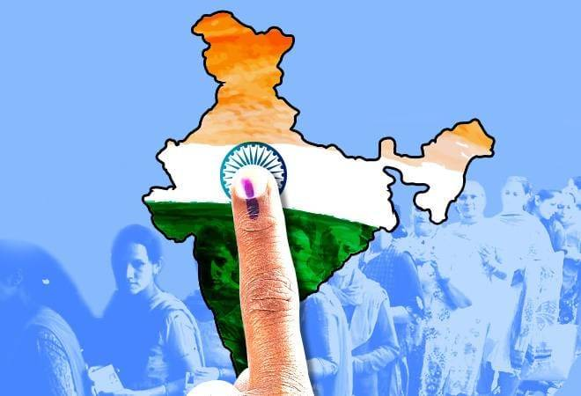
INDEX
Objective
Data Description
Data Integration
Data Cleaning
Dashboard Overview
POWER BI Dashboard
Insights
Recommendations

Slide 3

OBJECTIVE
The objective of this task is to analyze the 2024 election data to gain insights into the election results,
party performance, and voter trends across various constituencies. You will use Power BI or Tableau to
create interactive visualizations and dashboards that will help stakeholders understand the election
outcomes and the dynamics between different political alliances.

Slide 4

DATA DESCRIPTION
1. Election Results Data:
`_id`: Unique identifier for each record.
`State`: Name of the state.
`Const. No.`: Constituency number.
`Constituency`: Name of the constituency.
`Leading Candidate`: Name of the leading candidate.
`Leading Party`: Name of the leading party.
`Trailing Candidate`: Name of the trailing candidate.
`Trailing Party`: Name of the trailing party.
`Margin`: Vote margin between the leading and trailing candidates.
`Status`: Status of the election result (e.g., Won, Lost, Leading, Trailing).

Slide 5
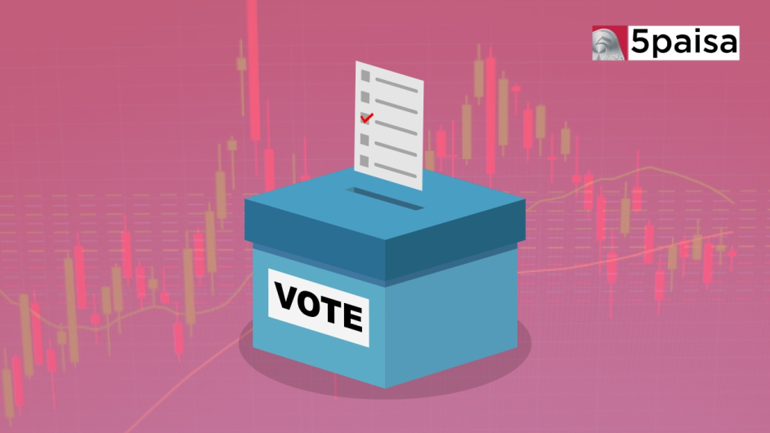
DATA DESCRIPTION
2. Party Alliance Data:
`Party Name`: Name of the political party.
`Alliance Name`: Name of the political alliance the party belongs to.

Slide 6
DATA INTEGRATION
We merged Election Results Data with Party Alliance Data to create a comprehensive dataset. This integration offers a detailed view of which alliances are leading or trailing in different constituencies, enabling an in-depth analysis of political power distribution and voter preferences.
This comprehensive approach provides valuable insights into the dynamics between political alliances and their influence on election outcomes.

Slide 7

DATA CLEANING
Data cleaning, also known as data cleansing, is the crucial process of identifying and correcting or removing errors, inconsistencies, and inaccuracies in datasets. Its main purpose is to ensure that data is accurate, complete, and reliable for analysis and decision-making.
This important process involves various tasks, such as:
removing duplicate records
handling missing values
correcting formatting errors
resolving inconsistencies

Slide 8
DASHBOARD OVERVIEW
Interactive Dashboard – Created in POWER BI for analyzing election data 2024.
Filters – Explore data by state, constituency, party, alliance and status.
KPIs – Includes total seats won, margin and constituencies won by alliances.
Visualisations – Summarizes overall results, state wise performance, constituency analysis, party and alliance comparisons and trends.

Slide 9
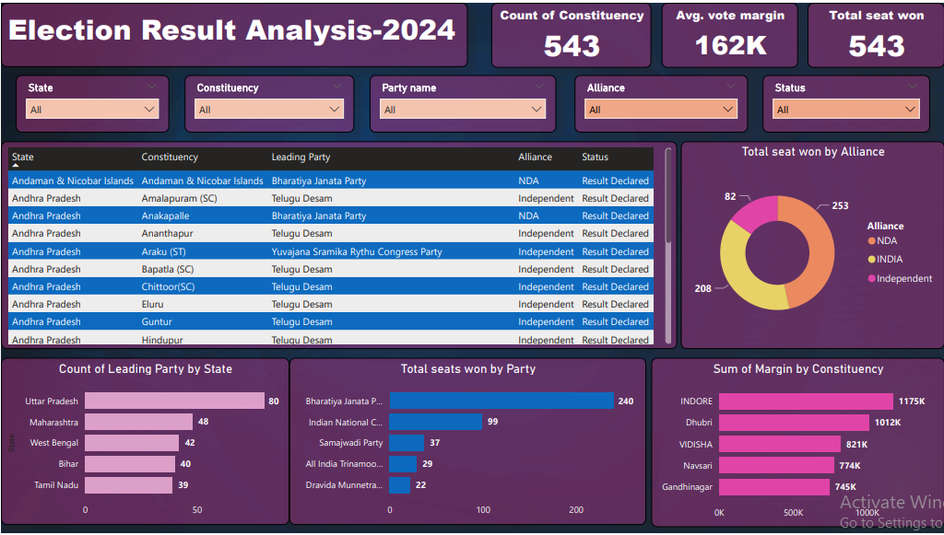
POWER BI DASHBOARD

Slide 10
INSIGHTS
There are 543 constituencies in India.
BJP leading with 240 wins, making it the most successful party in this dataset.
NDA Alliance won 253 seats out of which Bharatiya Janata Party won 240 seats.
INDIA Alliance won 208 seats out of which Indian National Congress won 99 seats only.
Minimum seats are taken by BJP in Sikkim.
Independent parties won 82 seats in various constituencies.
Surat was the constituency where the BJP candidates won without opposition.

Slide 11
INSIGHTS
Yuvajana Sramika Rythu Congress Party (YSRCP):Leading in losses with 87.
Indian National Congress (INC):Close behind with 86 losses.
Bharatiya Janata Party (BJP): 70 losses.
All India Trinamool Congress: 26 losses.
There is often a consistent trend where specific candidates from the Telugu Desam and YSRCP are either leading or trailing, indicating strong competition between these two parties.

Slide 12
RECOMMENDATIONS
BJP Strategies - Continue strengthening areas of dominance while addressing regions with significant losses.
INC Focus Areas - Leverage their relatively high number of wins and focus on converting close losses to victories by addressing local issues.
Regional Parties - Regional parties like DMK, Telugu Desam, and Samajwadi Party should focus on consolidating their positions and forming strategic alliances to increase their influence.

Slide 13
RECOMMENDATIONS
Analyze Competition - All parties should analyze the strategies and voter bases of their main competitors to identify areas for potential growth or where they need to defend their position more robustly.
Voter Engagement - Increase voter engagement in regions with historically high margins to maintain support while also investing resources in areas with smaller margins to convert potential voters.

Slide 14


